Slide 1
NetDiffusion: Network Data Augmentation Through Protocol-Constrained Traffic Generation
Xi Jiang^{1*}, Shinan Liu^{1*}, Aaron Gember-Jacobson², Paul Schmitt³, Francesco Bronzino⁴, Nick Feamster ¹
SIGMETRICS 2024
¹ University of Chicago, ² Colgate University, ³ University of Hawaii, Manoa / Invisv, ⁴ ENS Lyon

Slide 2
Network Trace Datasets
Why do we need them?
Training ML models for:
Anomaly Detection,
Activity Recognition,
....
What are these datasets?
Network Trace Dataset
NetFlow/IPFIX-style aggregated statistics
Raw traffic traces (pcaps)
Hardware/Software testing
And more…
Notes:
So network trace datasets generally fall into two categories, either flow-level statistics, which include data like duration and byte counts, or raw traffic traces in formats like pcaps or tcpdumps.
And these datasets are useful in many downstream tasks like training machine learning models for traffic analysis and conducting hardware or software testing.

Slide 3



Scarcity of Datasets
Potential Solution: Synthetic network data generation
Privacy/confidentiality
Maintenance Costs
Collection Errors
Notes:
However, the availability of these datasets are limited because of concerns in publicly sharing them, including privacy leaks, maintenance costs, and potential collection problems.
1. To address this scarcity, one solution is to derive synthetic data from existing datasets.

Slide 4
Simulations/heuristics approaches:
Pro: Can produce full headers/payloads (pcaps)
Cons:
Require extensive manual effort and domain knowledge
Non-generative, i.e., low levels of variations
ns-3
YANS
MGEN
Notes:
Early methods for generating synthetic network data, like ns-3, YANS, and MGEN, can produce traffic with full headers and payload, but need a lot of manual effort and domain knowledge to configure.
And they mainly retransmit existing traffic, meaning that they only change meta-attributes like timestamps or traffic rate but leave the traffic content relatively untouched.
So, while useful, they limited for improving ML models which often want some variation in generated traces to enhance model's robustness against unseen events.

Slide 5
GAN-based Generations
Pros:
Generative: Introduce variations
Attempts to achieve high statistical resemblance to real data
DoppelGANger
NetShare
Notes:
More state of the art solutions for producing synthetic network data start to use automated ML techniques such as generative neural networks.
With representative tools such as DoppelGANger and NetShare.
These models produce non-identical yet realistic variations of real traces, which can help simulating unseen events in the original dataset. At the same time, they aim to maintain high overall statistical similarity to real data to maximize the synthetic data's practical use in real-world scenarios.

Slide 6
GAN-based Generations
Pros:
Generative: Introduce variations
Attempts to achieve high statistical resemblance to real data
Cons:
Unsatisfactory ML accuracy
DoppelGANger
NetShare
Notes:
While these GAN-based tools are great, they have notable limitations due to the current design choices.
First, ML models often experience low accuracy when using these synthetic.

Slide 7
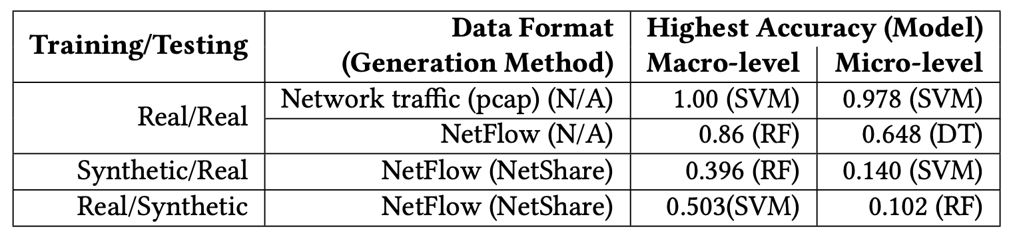

GAN-based Generations
Unsatisfactory ML accuracy
Goal: Generation of raw network traffic.
Notes:
For instance, using NetShare as an example which produces netflow like attributes,
We first see that training and testing a model for service classification on completely real NetFlow data is much more accurate than when synthetic data is used. This can potentially be because these synthetic data fails to adequately preserve critical distinguishing feature values in the real dataset, which negatively affects the models’ in classification accuracy.
And secondly, most current methods generate only aggregated flow-level statistics, and even when they attempt to produce packet-level details, they include only a few packet headers.
But we see that learning from raw network traffic such as pcaps tend to produce higher accuracy than learning from netflow like attributes since there are much more useful information to learn from.
These observations prompt us to explore whether it is feasible to generation raw network traffic to retain the fine-grained details and statistical properties of real network traffic to overcome this ML accuracy gap.

Slide 8
GAN-based Generations
Pros:
Generative: Introduce variations
Attempts to achieve high statistical resemblance to real data
Cons:
Unsatisfactory ML accuracy
Limited Applicability to Non-ML tasks.
Does not support retransmission and in-depth analysis
Does not emphasize on conformance to network rules
DoppelGANger
NetShare
Notes:
At the same time, these methods generally have Limited Applicability to Non-ML tasks due to the fact that they only produce summary attributes which makes critical functionality such as retransmission and in-depth analysis like wireshark impossible.
And they generally do not enforce network-specific rules during generation, meaning while the statistical resemblance can be high, the produced traffic doesn’t necessarily conform to protocol standards.

Slide 9
GAN-based Generations
Shortcomings:
Unsatisfactory ML accuracy
Limited Applicability to Non-ML tasks.
Can we address these concerns?
Ideal tool: An interactive generator where we can ask the generator the type of raw network traffic we want.
Notes:
Now the question is, can we design a generation pipeline to avoid these issues?
1. And specifically, in an ideal world, it would be great if we can create a dedicated, interactive generator like ChatGPT where we can ask it the type of traffic we want and it can produce it according to our request.

Slide 10
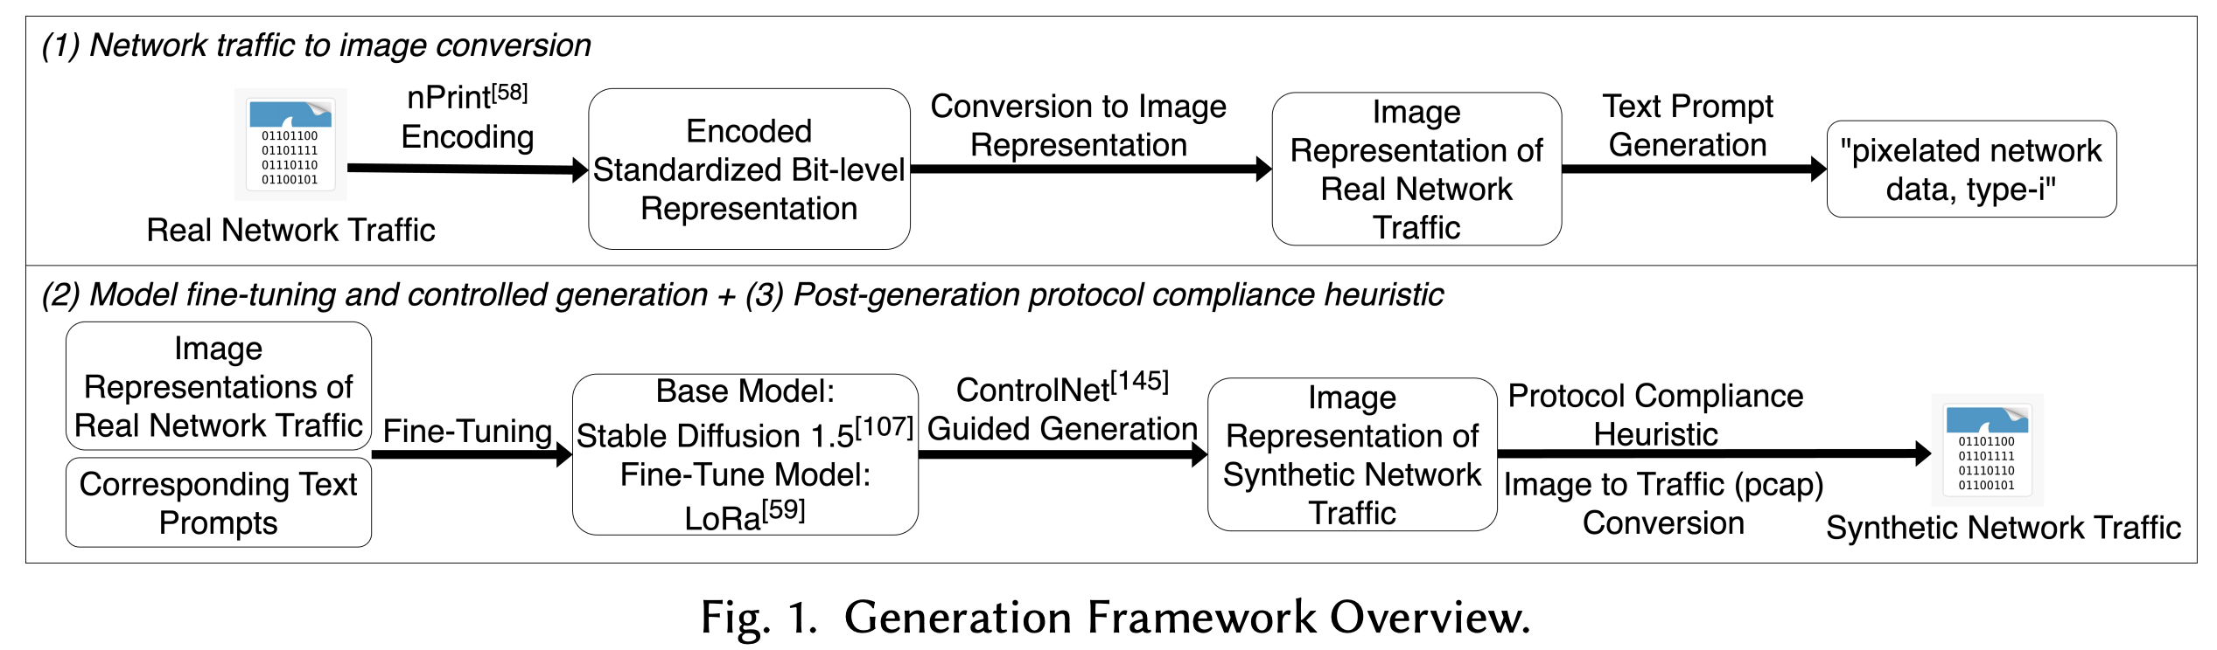
Our approach: a text-to-traffic synthesis paradigm
A generative text-to-image diffusion model on image-representations of raw network traces (pcaps).
Notes:
Inspired by the success of recent text-to-image models, we propose a framework that harnesses controlled text-to-image diffusion models to generate synthetic raw network traffic that complies with transport and network layer protocol rules.
This framework is consisted of three components which starts off with converting real network traffic used for training the generation model into image representations.
The second component involves fine-tuning the generation model using the image dataset and carry out controlled generation to largely make sure that the generated protocol and header field distributions are correct.
And the last step would be carry out detailed post-generation heuristic to further ensure protocol compliance by examine each generated header field bits in detail and correct them if needed.

Slide 11
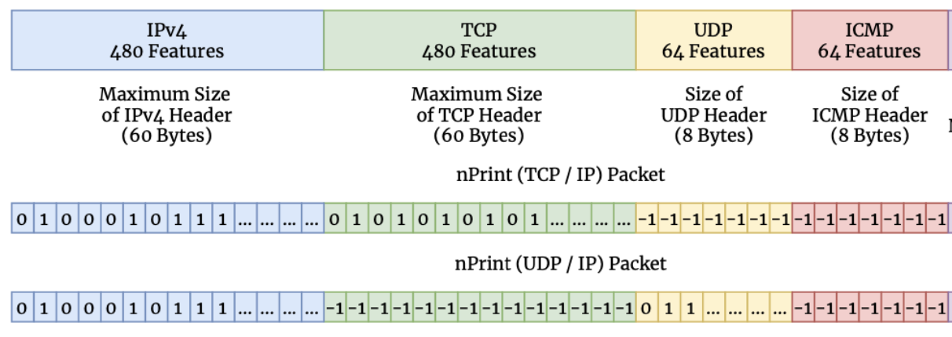
Our approach: a text-to-traffic synthesis paradigm
Generation Overview:
Step 1 – Training dataset curation (using nPrint-encoded pcaps)
Dataset Curation
Encoded pcap-to-image conversion
Label-based prompt generation, e.g., ‘type-0, Netflix traffic’
Notes:
In the generation stage of this framework, the first step is to create a dataset for model fine-tuning using real pcaps.
These pcaps are converted into a standardized numerical format using tools like nprint, which transforms header field bits into 1s, 0s, and -1s to represent set, unset, and absent bits.

Slide 12
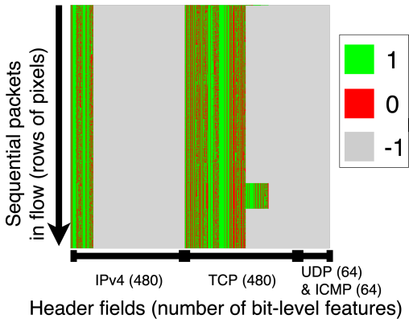
Our approach: a text-to-traffic synthesis paradigm
Generation Overview:
Step 1 – Training dataset curation (using nPrint-encoded pcaps)
Dataset Curation
Why image representation?
Powerful text-to-image diffusion models with high resolution → Improved feature granularity
Prompt-invoked generation → Class Imbalance Avoidance and style learning
Captures inter-packet relations → utilization of controlled generation techniques
Encoded pcap-to-image conversion
Label-based prompt generation, e.g., ‘type-0, Amazon traffic’
Notes:
The encoded pcaps are then turned into images paired with text prompts from data labels for fine-tuning a text-to-image diffusion model.
An example here is a TCP flow image where each row of pixels here represents transport layer header values of a packet in the flow.
1. The natural question to ask here is, why an image representation.
2. First, this allows us to use many of the existing powerful text-to-image diffusion models capable of producing images with high resolutions, which is particular helpful as we aim to improve feature granularity in synthetic data.
3. Second, most text-to-image models use prompt-invoked generation, which offers control over the quantity of class instances produced and allows the model to learn traffic characteristics corresponding to text prompts.
4. And lastly, this representation effectively captures inter-packet relations within a flow. Because, unlike traditional tabular formats where data points might be perceived as independent entities, images inherently emphasize the significance of a packet concerning its neighboring packets, preserving crucial contextual information.
For instance, in this TCP flow image, we can clearly see that all packets are TCP type since only the IP and TCP pixel columns are colored with green or red. And as we show later, this allows us to use controlled generation techniques designed for text-to-image models.

Slide 13
Our approach: a text-to-traffic synthesis paradigm
Generation Overview:
Step 2 – Fine-tuning a text-to-image diffusion model
Dataset Curation
LoRa-based Stable Diffusion 1.5 Fine-tuning
Why fine-tuning?
Training a diffusion model from scratch is costly
Fine-tuning techniques allow for few-shot learning → high generalizability
Encoded pcap-to-image conversion
Label-based prompt generation
Fine-tuned text-to-image model
Notes:
To fine-tune the text-to-image model, we used a cost-effective method called low-rank adaptation on Stable Diffusion 1.5, a model pre-trained on billions of general images.
1. We choose fine-tuning an existing model because training a diffusion model from the beginning is resource-intensive, requiring a large amount of data. Second, fine-tuning actually enhances the model's adaptability to various generation tasks. It resembles few-shot learning, where only a small amount of network data is needed to tailor the model to specific generation objectives.

Slide 14
Our approach: a text-to-traffic synthesis paradigm
Generation Overview:
Step 3 – Controlled Generation, e.g., protocol utilization across packets
Dataset Curation
LoRa-based Stable Diffusion 1.5 Fine-tuning
ControlNet (Canny)-aided Generation
Encoded pcap-to-image conversion
Label-based prompt generation
Fine-tuned text-to-image model
Constrained Generation
Input example: ‘type-0, Amazon traffic’
Notes:
During generation, we give the model the prompt that specifies the type of traffic we want and produce the output. However, during generation, we apply constrains using the tool ControlNet.

Slide 15
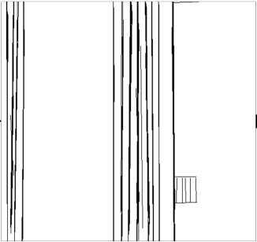
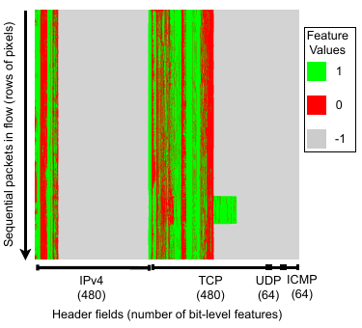
Our approach: a text-to-traffic synthesis paradigm
Generation Overview:
Step 3 – Controlled Generation, e.g., protocol utilization across packets
ControlNet Input
Constraint Detection
Constrained Generation
ControlNet (Canny)-aided Generation
Constrained Generation
Notes:
ControlNet takes an input of a single example image of the desired network traffic that we want to produce more synthetic versions for.
It carries out edge detection on the example, which in this case marks the region of generation to only TCP and IP header fields.
During generation, it uses these edges as references and ensures that the generated data follows this patterns to only produce TCP packets.

Slide 16
Our approach: a text-to-traffic synthesis paradigm
Post-Gen Heuristic Overview:
Inter-Packet Rules
E.g., TCP handshake
Intra-Packet Rules
E.g., checksum consistency with payload
“A set of header fields that have low tolerance to randomness.”
Notes:
As a result, we let the controlled generation to fullfill general conformance to the protocol and header field values distributions to the real data, but then further modify and correct the details within the synthetic data to ensure higher levels of compliances to protocol rules. Specifically we divide these into both inter and intra packet rules.
For inter-packet rules, we are looking at the relationships and sequencing between header fields within multiple packets in a network flow. For instance, in a typical TCP connection, packets need to be sequenced properly, starting with the handshake process.
For Intra-Packet Rules we are referring the correctness of the structure and contents within individual packets.
For example, many protocol headers have a checksum field computed based on the packet’s contents to detect errors during transmission. It’s crucial that the checksum is consistent with the packet’s payload.
So to maximize compliance with transport and network layer protocol rules, we first identify a subset of these critical header fields that mandate strict adherence, e.g., sequence and acknowledgement numbers. On the other hand, some fields can accommodate a degree of flexibility without necessarily severally compromising the traffic integrity, such as TCP window size or TTL. The objective here is to limit the scope of fields requiring modification during post-processing, ensuring we retain as much of the original generative model’s output as possible and minimize potential impacts on ML-driven tasks, while still ensuring the synthetic traffic’s compatibility with network analysis tools.

Slide 17
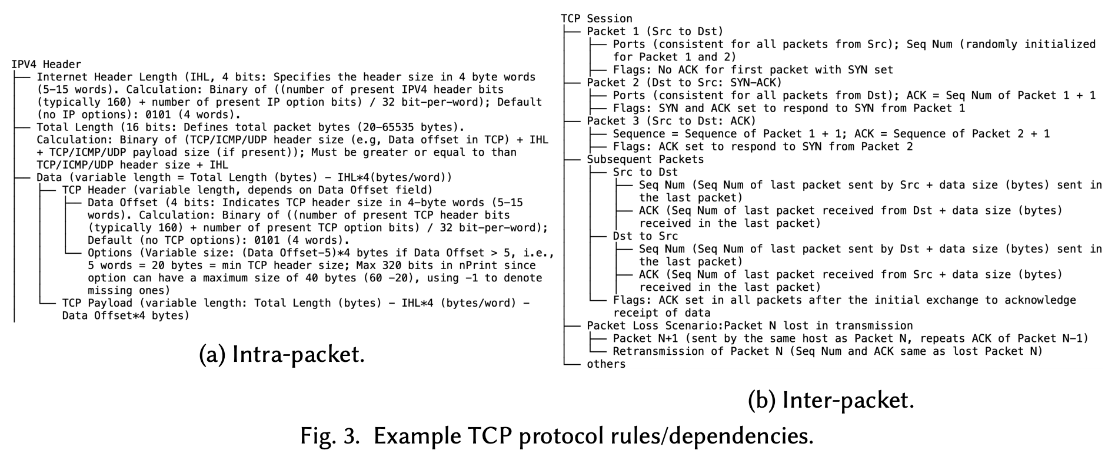
Our approach: a text-to-traffic synthesis paradigm
Post-Gen Heuristic Overview:
Notes:
We then constructing dependency trees to represent these rules. And for our generated traffic, we traverse the trees bottom-up fashion.
We first make sure that the intra-packet dependencies are satisfied to ensure that individual packets are internally consistent. We then address inter-packet dependencies, guaranteeing that the packets in a flow relate correctly to one another.
For fields that require random initialization or uniformity across packets such as IP addreses and ports, we use majority voting based on the generated values to determine the values.

Slide 18
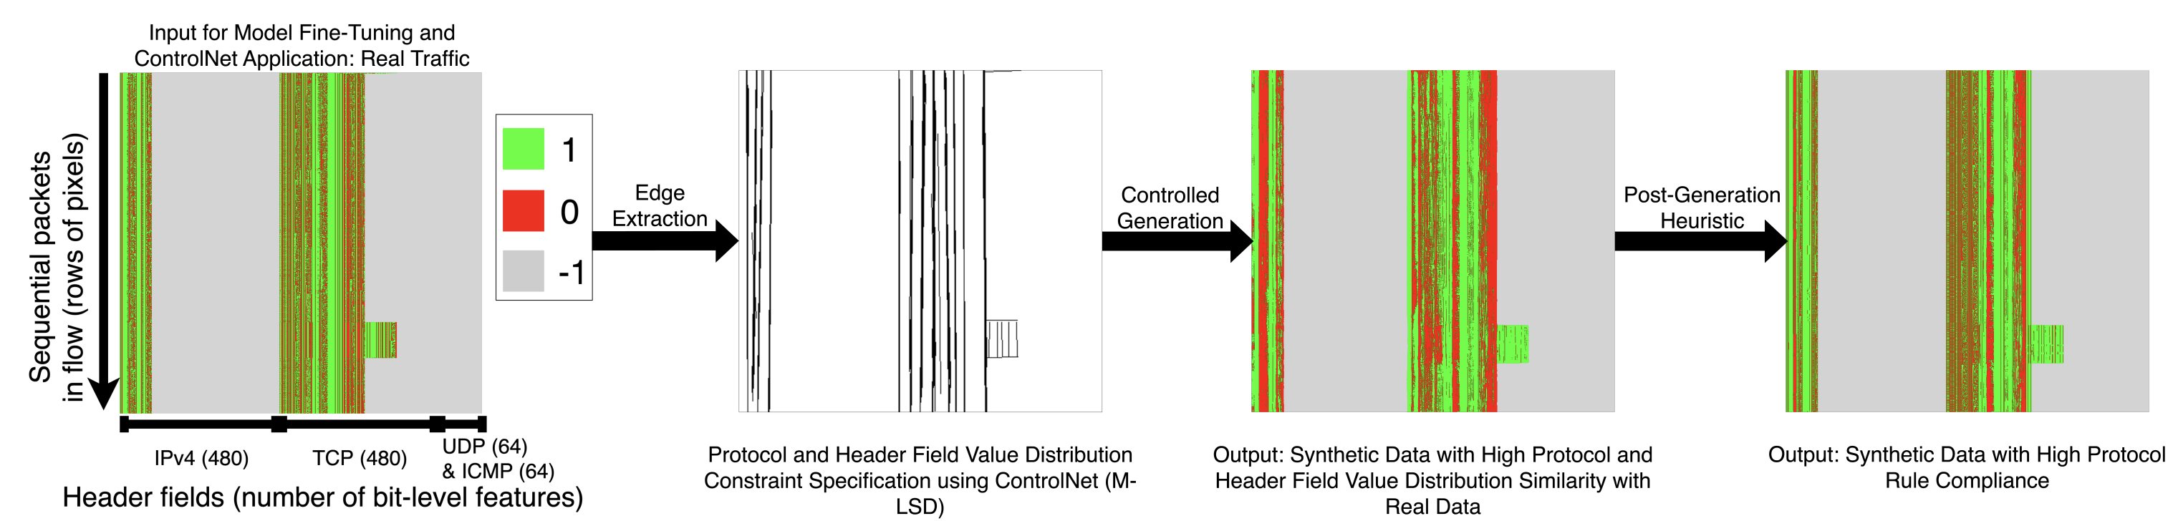
Our approach: a text-to-traffic synthesis paradigm
Post-Gen Heuristic Overview:
Notes:
And we can see that, after this post-generation heuristic, while still showing variations from the real data, we are seeing much more detailed structure compared to the original output from the controlled generation.

Slide 19
Our approach: a text-to-traffic synthesis paradigm
Generation Overview:
Step 4 – Synthetic image generation and conversion back to encoded pcaps
Dataset Curation
Encoded pcap-to-image conversion
Label-based prompt generation
Fine-tuned text-to-image model
Constrained Generation
Image representation of encoded pcap
Image-to-encoded pcap conversion
Notes:
The last step of the framework would be taking this produced image representation and
1. convert it back into encoded pcap format which can be used for downstream tasks.

Slide 20
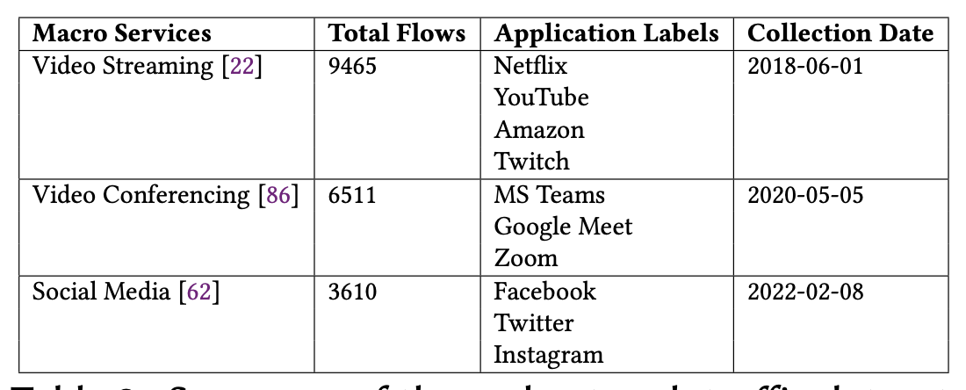
Evaluation
How do these improvements benefit downstream tasks?
We fine-tune the diffusion model using a real dataset (10 applications/3 services)and use it to generate synthetic traffic data.
Training Dataset | Generation Method 1 | Generation Method 2
Real network traces from 11 applications / 3 service types | Our text-to-traffic framework | Time-series based GAN (NetShare)
Notes:
To evaluate how this framework actually benefits the downstream task,
We fine-tune this framework with real network traces from 3 service types such as streaming versus web browsing, which are further broken down in 10 applications such as Netflix and YouTube.
We use the same data to train NetShare, which is a time-series-based GAN generator capable of generating netflow-like attributes and use that as a baseline.

Slide 21
Evaluation
Analysis Evaluation (statistical similarity):
> 30 %
> 70 %
Average Statistical Improvement (common fields)
Average Statistical Improvement (all fields)
Notes:
We first look the statistical similarity of our synthetic data compared to the real data.
We see that, on fields that both our method and the baseline method generates such as the the protocol used, we see an average of greater than 30% improvement in statistical similarity measured using metrics such as jsd and EMD. And on all of the fields generated, our method see over 70% improvement over the baseline.

Slide 22
Evaluation
Analysis Evaluation (traffic classification accuracy):
> 65 %
(a) Train on Synthetic; Test on Real
Notes:
We now look the impact of our synthetic data on machine learning tasks, particularly traffic classification aiming at categorizing flows into particular services or applications.
We first allow the training of the model completely on synthetic data and test the model accuracy completely on real data. And on average we see an higher than 60% improvement in accuracy when our synthetic data is used compared to the baseline synthetic data. This enhanced performance is attributed to our higher granularity, which inherently provide more features for learning, as well as our controlled generation process that attempts to mimic real protocol and header field value distributions.

Slide 23
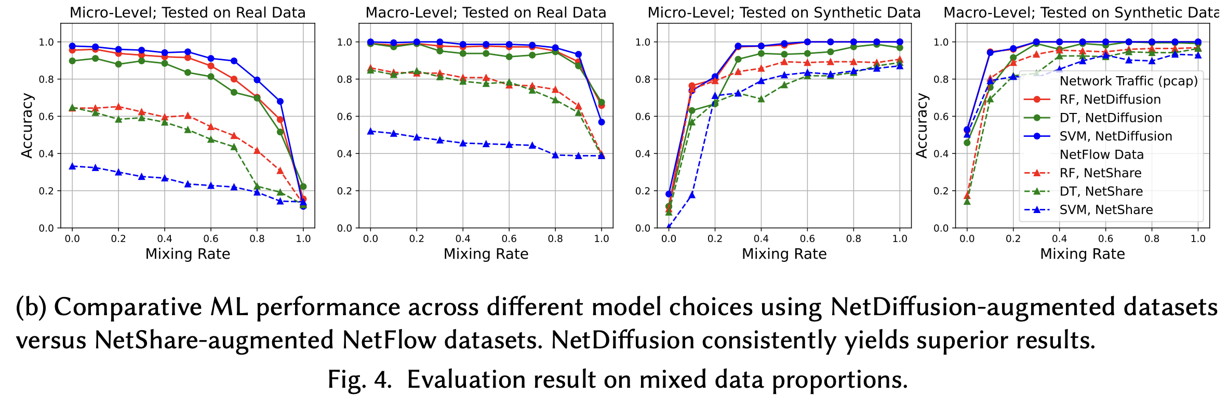
Evaluation
Analysis Evaluation (traffic classification accuracy):
Notes:
We then look at the scenarios where the training is done using a mixture of both real and synthetic data by gradually replacing proportions of the real training data with the synthetic data, and across all scenarios, ML models that use our synthetic data is able to outperform those that use the baseline synthetic data.

Slide 24
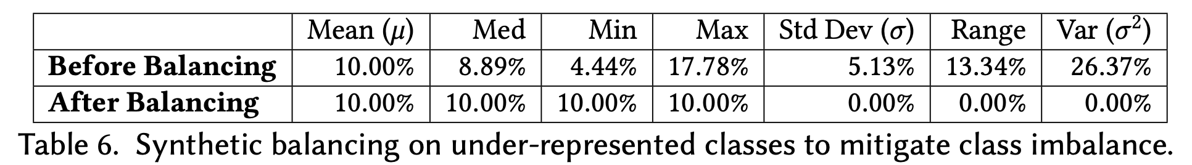
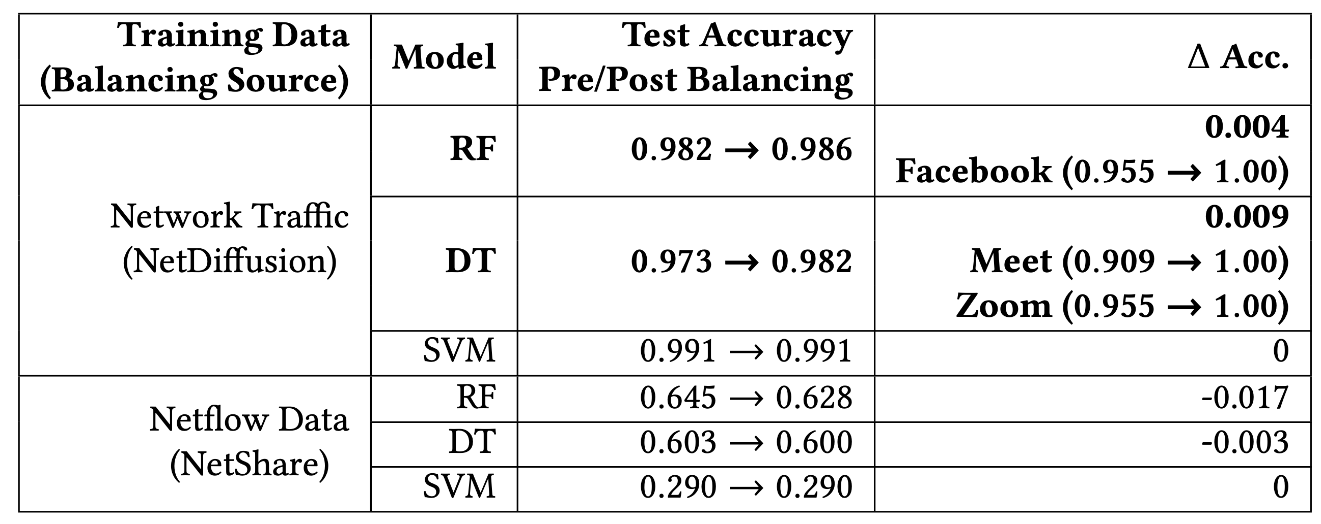
Evaluation
Analysis Evaluation (traffic classification accuracy – class balancing):
Notes:
Last we look at the case where we try to use synthetic data to solve the problem of class imbalance. Here we populate under represented classes using the synthetic data points until these classes have the same number of instances as the most popular class.
1. And we can see that, the machine learning accuracy actually improves when we carry out class balancing using NetDiffusion data and for particular classes that are underrepresented such as facebook meet and zoom in this case, the classification accuracy actually improves by a significant amount as we drastically increased their presence using high quality data that resembles the real instances. Which is not necessarily the case of the baseline.

Slide 25
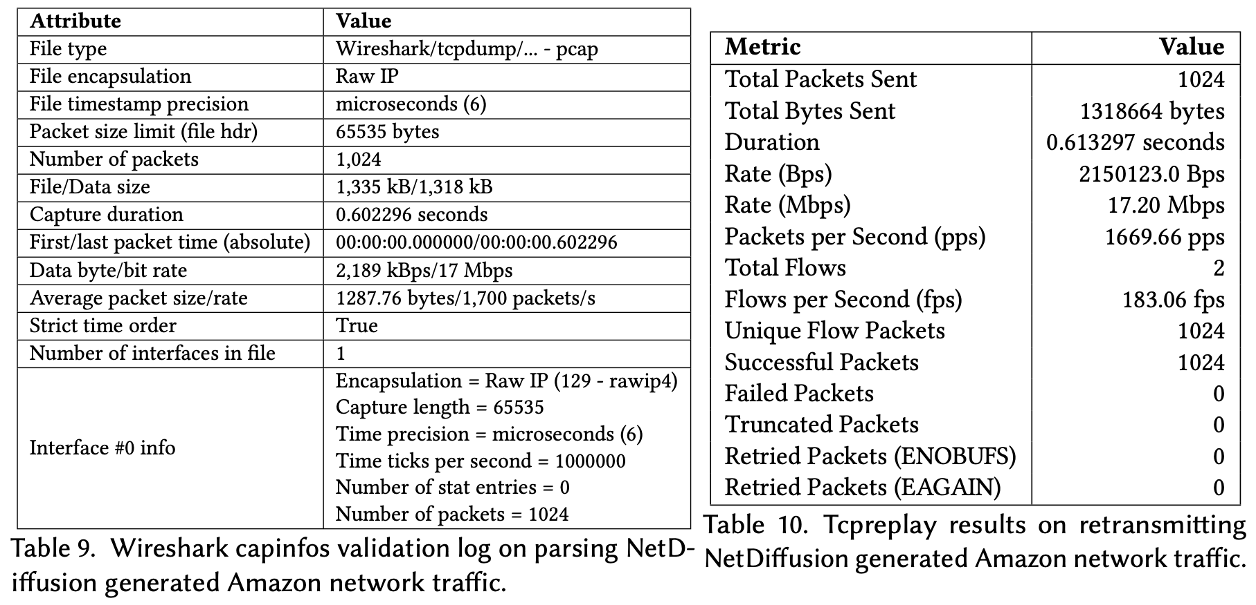
Evaluation
Analysis Evaluation (non-ML tasks):
Compatibility with WireShark and TCPReplay
Notes:
Now we look at the performance of NetDiffusion data with non-ML tasks.
1. We first verify that our data is highly compatible with both WireShark and TCPReplay with no significant errors or exceptions raised when our generated data is passed into these tools

Slide 26
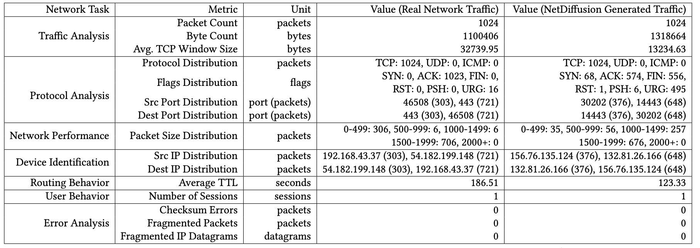
Evaluation
Analysis Evaluation (non-ML tasks):
Compatibility with WireShark and TCPReplay
Feature Extraction for Core Network Analysis Tasks
Notes:
We then survey a list of network operation tasks and show that essential metrics for these tasks can be successfully derived from our data, including tasks ranging from traffic analysis to routing behavior analysis.
As you can see that there are still certain fields such as the TCP flags that are not 100% as expected in our data, and we are actively working on these further formulating these fields by adding additional techniques such as incorporating a tcp state machine or by training from scratch a dedicated control model and constraint bounded generation and denoising steps.

Slide 27
Possibilities and Challenges
We advocate for a paradigm shift towards generation of highly-granular, protocol-compliant network traces, using a text-to-traffic diffusion model as a pilot analysis.
Context transferring
Network traffic dimensionality
Generative foundation model beyond traffic generation
Notes:
To wrap up, we show that our proposed paradigm is promising for generating these highly granular and realistic traffic data.
However there remains many challenges that are worth looking into.
1. For example, in this framework, the model's efficacy is tested only with producing already-seen traffic. Future work could explore using the prompt-based nature of text-to-image diffusion models for context transferring, for instance, if we fine-tune or train a model using TLS encrypted Youtube traffic and VPN-encrypted Netflix traffic, can we design the model in such a fashion where it can learn the VPN encryption style and produce VPN-encrypted Youtube traffic without ever seeing it.
2. Additionally, network traffic data comes with variable input/output lengths and high dimensionality which produce unique challenges. For example our current framework is limited by the image dimension which confines the image to 1024 rows of pixels, meaning 1024 packets, this highlights the need for specialized models and optimization techniques for effective traffic data synthesis. This limits not only to diffusion models but also LLMs as well where the token cap can pose constrains.
3. Lastly, it would be great if we can create a foundation model that resembles something like stable diffusion, but specifically for networking scenarios, which does not limit to traffic generation.

Slide 28
GAN-based Generations
Inter-arrival-time (IAT) Example:
Real IAT for 3 flows = [10 ms, 11 ms, 11 ms]
Average IAT across real data points = 10.67 ms
Generated IAT for 3 flows = [10.5 ms, 10.5 ms, 11 ms]
Average IAT across synthetic data points = 10.67 ms
DoppelGANger
NetShare
Notes:
For instance, when generating synthetic inter-arrival times for flows, we aim for the overall average to closely match real data, while allowing minor variations in individual data points.

Slide 29
Original Eval in NetShare
Original:
Generator Training Dataset | Features Used | Generation Method | Avg. Accuracy
TON (Anomaly Detection) | All produced features | NetShare | ~ 0.60
 |  | CTGAN | ~ 0.50
 |  | STAN | ~ 0.40
 |  | E-WGAN-GP | ~ 0.10
Our Evaluation:
Generator Training Dataset | Features Used | Generation Method | Avg. Accuracy (service: 3-class) | Avg. Accuracy (application: 10-class)
Service/Application Traffic | All produced features (excluding IPs, ports) | NetShare | 0.42 | 0.2
 |  | Ours | 0.72 | 0.31

Slide 30
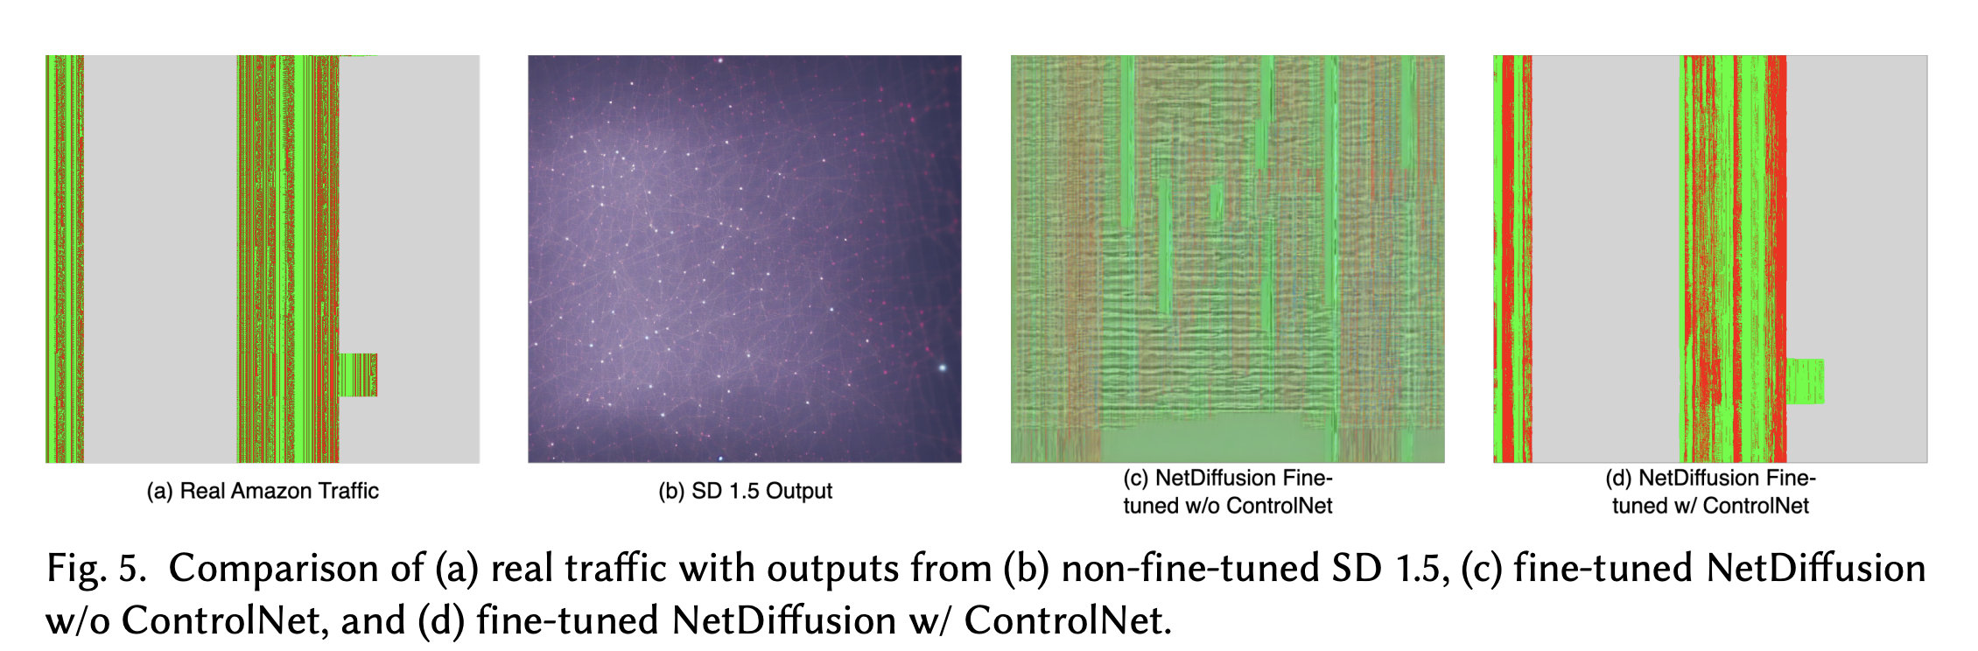
Evaluation (Ablation)

